Slide 1
UNIT-4: Unsupervised Learning
Introduction to Clustering
Unsupervised vs Supervised Learning,
Different types of clustering techniques
– Partitioning Methods
– Hierarchical methods
– Density Based Methods
–Grid Based Methods
– Model Based Clustering Methods.
4. K-means clustering,
5. Apriori algorithm and
Association rule.
Hierarchical clustering, K-Medoids,
Density-based methods – DBSCAN.

Slide 2
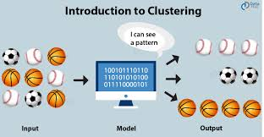
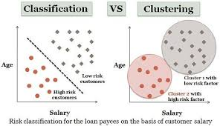
Overview of Clustering

Slide 3
Introduction to clustering?
Definition:-1
Clustering is the task of dividing the population or data points into a number of groups such that data points in the same groups are more similar to other data points in the same group and dissimilar to the data points in other groups.
It is basically a collection of objects on the basis of similarity and dissimilarity between them.
Definition:-2
"A way of grouping the data points into different clusters, consisting of similar data points. The objects with the possible similarities remain in a group that has less or no similarities with another group."

Slide 4
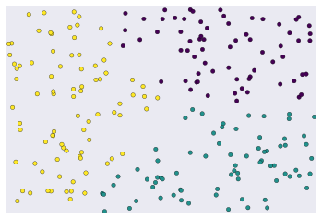
What is clustering?
Grouping unlabeled examples is called clustering.
As the examples are unlabeled, clustering relies on unsupervised machine learning.
If the examples are labeled, then clustering is called classification.
Figure 1: Unlabeled examples grouped into three clusters.

Slide 5
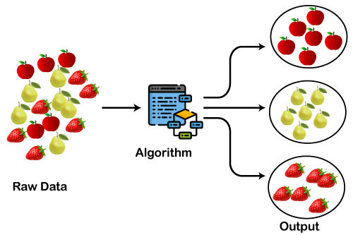
Examples

Slide 6
Differentiate between Classification and Clustering
Sr. No. | Classification | Clustering
01 | Classification is a supervised learning approac | Clustering is an unsupervised learning approach.
02 | Classification basically works by classifying the data with the help of class labels. | On the other hand, clustering is done by putting similar data points together. Grouping the instances based on their similarity.
03 | It uses a training dataset. | It does not use a training dataset.
04 | In classification, there are labels for training data. | In clustering, there are no labels for training data.
05 | It is more complex as compared to clustering. | It is less complex as compared to clustering.
06 | Logistic regression, Naive Bayes classifier, Support vector machines, etc. | k-means clustering algorithm, Fuzzy c-means clustering algorithm, Gaussian (EM) clustering algorithm, etc.

Slide 7
Types of Clustering Methods
The clustering methods are broadly divided into Hard clustering (data point belongs to only one group) and Soft Clustering (data points can belong to another group also).
Partitioning Clustering
Hierarchical Clustering
Density-Based Clustering
Model-Based Clustering
Grid Based Methods

Slide 8
What are the Uses of Clustering?
Common applications for clustering include the following:
market segmentation
social network analysis
search result grouping
medical imaging
image segmentation
anomaly detection
Examples of clustering(Grouping):
Group stars by brightness.
Group organisms by genetic information into a taxonomy.
Group documents by topic.

Slide 9
Types of Clustering Methods
The clustering methods are broadly divided into Hard clustering (data point belongs to only one group) and Soft Clustering (data points can belong to another group also).
Partitioning Clustering
Hierarchical Clustering
Density-Based Clustering
Model-Based Clustering
Grid-Based Methods

Slide 10
Partitioning Clustering
It is a type of clustering that divides the data into non-hierarchical groups.
It is also known as the centroid-based method.
The most common example of partitioning clustering is the K-Means Clustering algorithm.
In this type, the dataset is divided into a set of k-groups, where K is used to define the number of pre-defined groups.
The cluster center is created in such a way that the distance between the data points of one cluster is minimum as compared to another cluster centroid.

Slide 11
Working of K-Means Algorithm:
The following stages will help us understand how the K-Means clustering technique works:
Step 1: First, we need to provide the number of clusters, K.
Step 2: Next, choose K data points at random and assign each
data points to a cluster.
Step 3: The cluster centroids will now be computed.
Step 4: Iterate the steps below until we find the ideal centroid,
which is the assigning of data points to clusters that do not vary.
4.1 The sum of squared distances between data points and centroids would be calculated first.
4.2 At this point, we need to allocate each data point to the cluster that is closest to the others (centroid).
4.3 Finally, compute the centroids for the clusters by averaging all of the cluster’s data points.

Slide 12
The working of the K-Means algorithm is given below:
Step-1: Select the number K to decide the number of clusters.
Step-2: Select random K points or centroids. (It can be other
from the input dataset).
Step-3: Assign each data point to their closest centroid, which will form the predefined K clusters.
Step-4: Calculate the distances between data points and centroids first and allocate each data point to the cluster that is closest to the others (centroid). Place a new centroid of each cluster.
Step-5: Repeat the third steps, which means reassign each datapoint to the new closest centroid of each cluster.
Step-6: If any reassignment occurs, then go to step-4 else go
to FINISH.
Step-7: The model is ready.

Slide 13
Let's understand the above steps by considering the visual plots:
Step-1:Let us pick k clusters, i.e., K=2, to identify the dataset and to put them into different clusters.
Step2:- We need to select some random k data points or centroid to form the cluster.
These points can be either the points from the dataset or any other point.
So, here we are selecting the below two points as k points, which are not the part of our dataset.

Slide 14
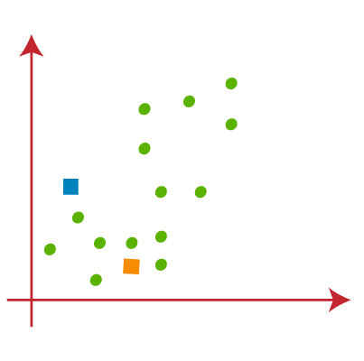
Consider the image below:
Now we will assign each data point of the scatter plot to its closest K-point or centroid.
We will compute it by applying some mathematics that we have studied to calculate the distance between two points.
So, we will draw a median between both the centroids.

Slide 15
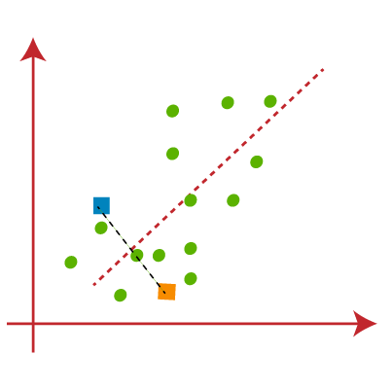
Consider the below image:
From the above image, it is clear that points left side of the line is near to the K1 or blue centroid, and points to the right of the line are close to the yellow centroid.
Let's color them as blue and yellow for clear visualization.
The left Form cluster has a blue centroid, whereas the right Form cluster has a yellow centroid.

Slide 16
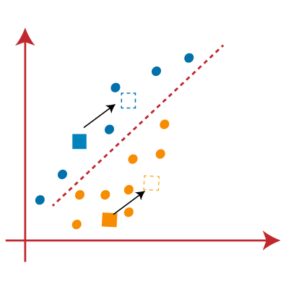
Repeat the procedure, this time by selecting a different centroid.
To choose the new centroids, we will compute the center of gravity of these centroids, and will find new centroids as below:

Slide 17
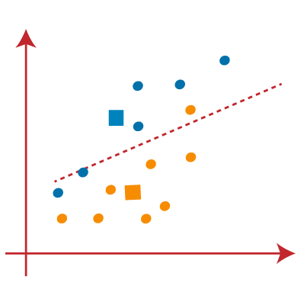
Next, we will reassign each data point to the new centroid. For this, we will repeat the same process of finding a median line. The median will be like below image:
From the above image, we can see, one yellow point is on the left side of the line, and two blue points are right to the line. So, these three points will be assigned to new centroids.

Slide 18
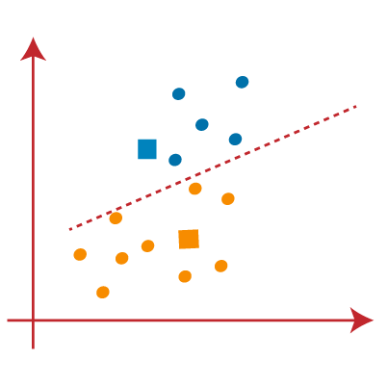
As reassignment has taken place, so we will again go to the step-4, which is finding new centroids or K-points.
We will repeat the process by finding the center of gravity of centroids, so the new centroids will be as shown in the below image:

Slide 19
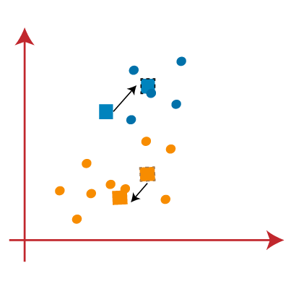
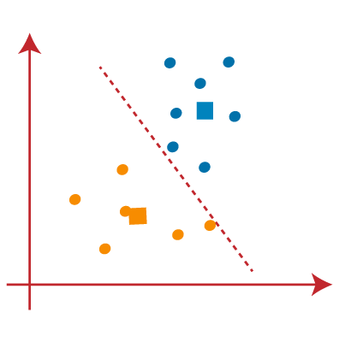
As we got the new centroids so again will draw the median line and reassign the data points. So, the image will be:
.

Slide 20
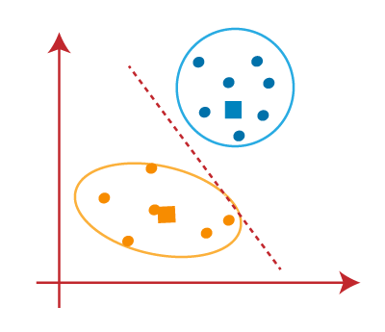
We can see in the above image; there are no dissimilar data points on either side of the line, which means our model is formed. Consider the below image:

Slide 21
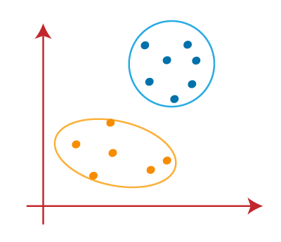
As our model is ready, so we can now remove the assumed centroids, and the two final clusters are as shown in the fig. below:

Slide 22
How to choose the value of "K number of clusters" in K-means Clustering?
Choosing the optimal number of clusters is a big task.
There are many different ways to find the optimal number of clusters, but here we are discussing the most appropriate method to find the number of clusters or value of K.
The method is Elbow Method:
The Elbow method is one of the most popular ways to find the optimal number of clusters.
This method uses the concept of WCSS value.
WCSS stands for Within Cluster Sum of Squares, which defines the total variations within a cluster.
The formula to calculate the value of WCSS (for 3 clusters) is given below:
WCSS= ∑_{Pi in Cluster1} distance(P_{i} C₁)² +∑_{Pi in Cluster2}distance(P_{i} C₂)²+∑_{Pi in CLuster3} distance(P_{i} C₃)²

Slide 23
Association rule
Association rule is a kind of unsupervised learning technique that tests for the reliance of one data element on another data element and design appropriately so that it can be more cost-effective.
The association rule learning is the most important approach of machine learning, and it is employed in Market Basket analysis, Web usage mining, continuous production, etc. In market basket analysis, it is an approach used by several big retailers to find the relations between items.
Association rule learning can be divided into three types of algorithms:
1. Apriori algorithm
2. Eclat algorithm
3. F-P Growth algorithm

Slide 24
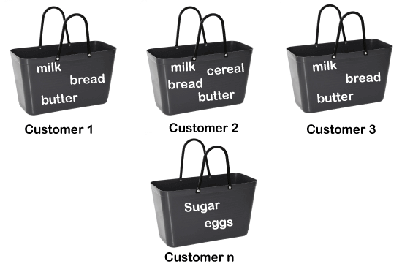
Associations: Market Basket Analysis

Slide 25

How does Association Rule Learning work?
Association rule learning works on the concept of If and Else Statement, such as if A then B.
To measure the associations between thousands of data items, there are several metrics.
These metrics are given below:
Support
Confidence
Lift

Slide 26
Rule Evaluation Metrics:
–Support(s) – The number of transactions that include items in the {X} and {Y} parts of the rule as a percentage of the total number of transaction.
It is a measure of how frequently the collection of items occur together as a percentage of all transactions.
-Support(σ) =(X+Y)/total – It is interpreted as fraction of transactions that contain both X and Y.
Confidence(c) – It is the ratio of the no of transactions that includes all items in {B} as well as the no of transactions that includes all items in {A} to the no of transactions that includes all items in {A}.

Slide 27
Conf(X=>Y) = Supp(XY)Supp(X) – It measures how often each item in Y appears in transactions that contains items in X also.
Lift(l) – The lift of the rule X=>Y is the confidence of the rule divided by the expected confidence, assuming that the itemsets X and Y are independent of each other.The expected confidence is the confidence divided by the frequency of {Y}.
Lift(X=>Y) = Conf(X=>Y)Supp(Y) – Lift value near 1 indicates X and Y almost often appear together as expected, greater than 1 means they appear together more than expected and less than 1 means they appear less than expected.Greater lift values indicate stronger association.

Slide 28
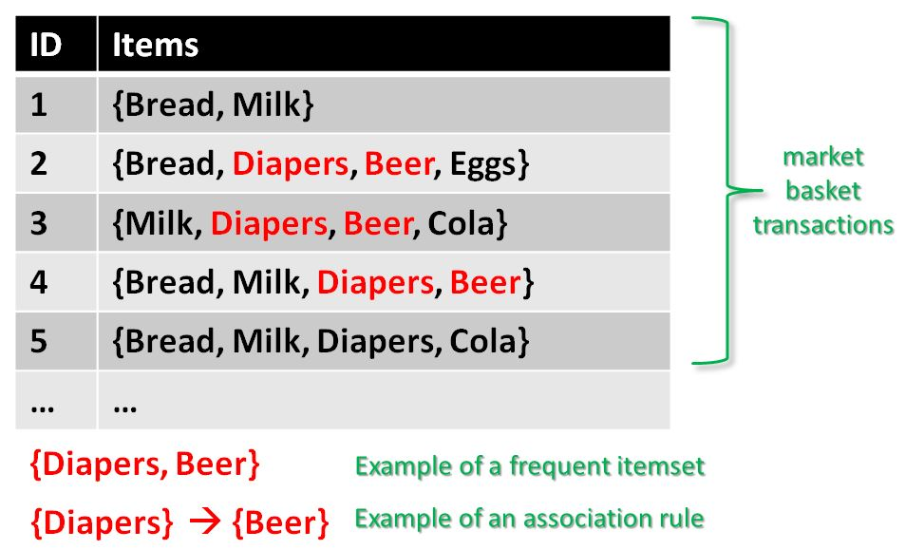
Applications of Machine Learning:
Learning Associations:

Slide 29
Support Count(σ) – Frequency of occurrence of a items. Here σ({Milk, Diaper, Beer})=2 σ({Bread, Diaper, Beer})=2
TID | Items
1 | {Bread, Milk}
2 | {Bread, Diaper, Beer, Eggs}
3 | {Milk, Diaper, Beer, Cola}
4 | {Bread, Milk, Diaper, Beer}
5 | {Bread, Milk, Diaper, Cola}

Slide 30
Association Rule – An implication expression of the form X -> Y, where X and Y are any 2 item sets.
Example: {Milk, Diaper}->{Beer}
Definition of Support:
Support is the frequency of A or how frequently an item set appears in the dataset.
From the above table:
Support(s)= σ ({Milk, Diaper, Beer})/|T| = 2/5
= 0.4
Where T is the total number of transactions.

Slide 31
Definition of Confidence:
How often the items X and Y occur together in the dataset when the occurrence of X is already given.
It is the ratio of the transaction that contains X and Y to the number of records that contain X.
From Example {Milk, Diaper} ―> {Beer}
Confidence(c)= σ(Milk, Diaper, Beer)/σ(Milk, Diaper)=2/3
=0.67

Slide 32
Definition of Lift(l): The lift of the rule X=>Y is the confidence of the rule divided by the expected confidence, assuming that the item sets X and Y are independent of each other. The expected confidence is the confidence divided by the frequency of {Y}.
If Lift(l)=1: It indicates X and Y almost often appear together as expected,
If Lift(l)>1: It means they appear together more than expected and
If Lift(l)<1: It means they appear less than expected. Greater lift values indicate stronger association.
Lift(l)= Support(X,Y)/(Support(X)*Support(Y))
l=Supp({Milk, Diaper, Beer})/ (Supp({Milk, Diaper})*Supp({Beer}))
= 0.4/(0.6*0.6)
=1.11

Slide 33
Applications of Association Rule Learning
Below are some popular applications of association rule learning:
Market Basket Analysis: It is one of the popular examples and applications of association rule mining. This technique is commonly used by big retailers to determine the association between items. By discovering such associations, retailers produce marketing methods by analyzing which elements are frequently purchased by users.
Medical Diagnosis: With the help of association rules, patients can be cured easily, as it helps in identifying the probability of illness for a particular disease.
Protein Sequence: The association rules help in determining the synthesis of artificial Proteins.
Web usage mining: Web usage mining is basically the extraction of various types of interesting data that is readily available and accessible in the ocean of huge web pages, from Internet.

